Slide 1
Rawlings Football Helmet Accelerometer System: Final Presentation
Naomi Ebstein
Seth Bensussen, Amanda Pavlicek
Group 17

Slide 2
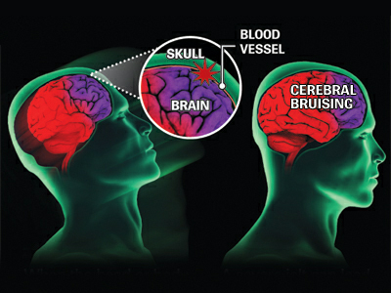
Need
Brain injuries occur in ~1.5 million people in the US each year
300,000 of these are sports related CONCUSSIONS
NFL in 2011, 266 players out of 1,696 suffered CONCUSSIONS (~15%)
Over 2000 ex-football players file lawsuit against NFL
http://www.riders4helmets.com/wp-content/uploads/2011/04/012709concussion2_54304a.jpg

Slide 3
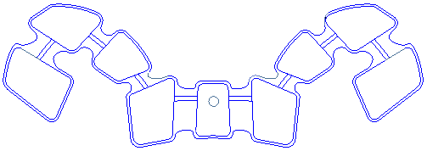
Specific Design Requirements
Rawlings size large Impulse helmet
Single-unit tri-axial accelerometer with gyroscope measuring linear and rotational acceleration
Mounting: Velcroed to rear of helmet shell, covered by foam
High Density Foam: VN740
Foam Thickness: ½” (1.27 cm)
Performance slightly decreased

Slide 4
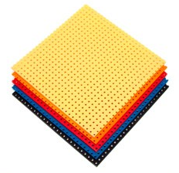
Specific Details of Chosen Design: Parts
Accelerometer
Tri-axial accelerometer with gyroscope
Being launched at trade show Jan 8-9 2013
Deliveries will not begin until March
Polycarbonate outer shell
Lead time 60-90 days
Cell-Flex Vinyl Nitrate Foam
Lead time 60-90 days
http://www.dertexcorp.com/impact-resistant-foam.html

Slide 5
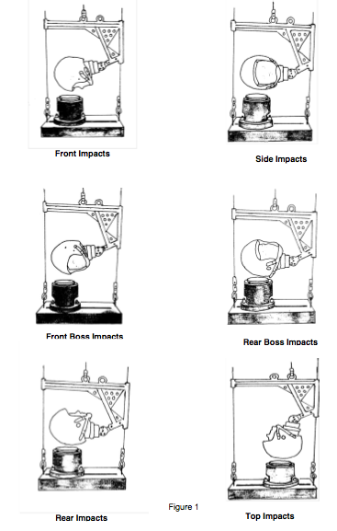
Specific Details of Analytic Designs: NOCSAE Testing
Tested at 4 velocities
3.46 m/s
4.23 m/s
4.88 m/s
5.46 m/s
Tested at 6 angles
Yields a Severity Index and Peak Acceleration
Severity Index must not exceed 1200
http://www.nocsae.org/standards/documents.html
Details of Testing
Helmet Drop Angles
Notes:
Must not exceed 300 in 3.46 drop

Slide 6
Specific Details of Analytic Designs: Normalizing Algorithm
Need to find a transfer function to normalize the data
Convolution in MATLAB
Problem: our data is really poor
Not repeatable for the accelerometer
Cannot get full waveform normal data because the system is broken

Slide 7
Specific Details of Analytic Designs: Normalizing Algorithm
Helmet Angle | Data Source | SI STD | Peak Acceleration (G) STD
Front | Headform | 5.03 | 2.52
 | Accelerometer | 55.85 | 13.46
Front Boss | Headform | 0.58 | 3.61
 | Accelerometer | 54.34 | 5.97
Side | Headform | 8.00 | 2.52
 | Accelerometer | 262.38 | 14.20
Rear | Headform | 14.01 | 1.53
 | Accelerometer | 177.87 | 20.73
Rear Boss | Headform | 4.04 | 6.43
 | Accelerometer | 498.80 | 58.11
Crown | Headform | 18.50 | 7.57
 | Accelerometer | 308.78 | 17.67
Random (Behind Accelerometer) | Headform | 7.81 | 5.13
 | Accelerometer | 207.73 | 6.07

Slide 8
Specific Details of Analytic Designs: Normalizing Algorithm
Normal Data
Normalizing Algorithm

Slide 9
Specific Details of Analytic Designs: Normalizing Algorithm
Used MATLAB to find a transfer function matrix
Needed to find a gain
Curve fit the transfer function: Gaussian function
$83.39∗e^{−{(\frac{t−2.753}{0.394})}^{2}}+4.992∗e^{−{(\frac{t−5.784}{0.197})}^{2}}+0.9747∗e^{−({\frac{t−7.915}{0.923})}^{2}}$
Comparing the maximum peaks: 3.6% error

Slide 10
Specific Details of Analytic Designs: Normalizing Algorithm
If we had better data…
Create a coordinate system to account for the angle from the center of gravity of the head
Have transfer functions for each drop
Each velocity and helmet angle
Have more iterations to verify the algorithm
But…
No system has used just one accelerometer

Slide 11
Conclusions
We did not quite solve the problem
Poor data
With more time, better data is possible
Future: optimize padding, get better data to see if normalizing algorithm can work

Slide 12
Lessons Learned
Project does not always turn out as expected
Time management and communication skills
Seek help early and often from many different sources

Slide 13
Questions?

