Slide 1
Rawlings Football Helmet Accelerometer System
Group 17
Presenter: Amanda Pavlicek
Group Members: Seth Bensussen & Naomi Ebstein, Amanda Pavlicek

Slide 2
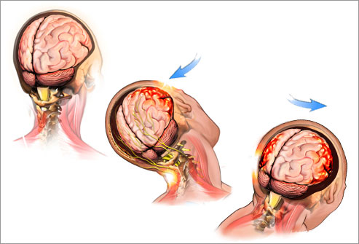
The Need for a Helmet Accelerometer System
Brain injuries occur in approximately 1.5 million people in the U.S. each year
300,000 of these are sports related concussions
http://myheadfirst.wordpress.com/tag/concussion-myths/
Notes:
As we mentioned in our first presentation…….

Slide 3
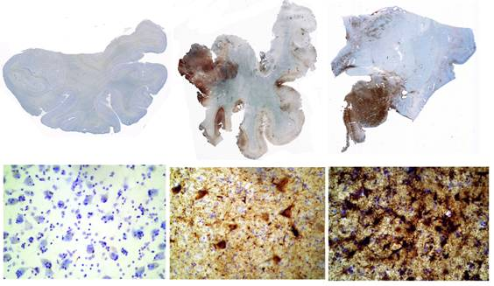
NFL
In 2011, 266 out of 1,696 NFL (15%) players suffered concussions
Over 2000 former NFL players filed lawsuits against the league
Chronic Traumatic Encephalopathy (CTE) has been found in over 20 deceased NFL players
http://www.bu.edu/cste/about/what-is-cte/
Notes:
Football has a higher incidence of concussion than any other sport.
Chronic Traumatic Encephalopathy (CTE) is a progressive degenerative disease of the brain found in athletes (and others) with a history of repetitive brain trauma, including symptomatic concussions as well as asymptomatic subconcussive hits to the head. Buildup of abnormal protein called tau. Causes memory loss, confusion, eventually progressive dementia

Slide 4
Project Scope
Retrofit a Rawlings size large Impulse helmet with an accelerometer system
Test the helmet retrofitted with the accelerometer system to ensure performance and safety are not compromised
Use the data collected to develop a method to normalize the impact values of the accelerometer to the center of gravity of the head
The helmet should be cheaper and provide data at least as accurate as the data from the existing Riddell football helmet accelerometer system
Notes:
While measures have been taken to reduce the number of players who return to a game after a concussion, there are still plenty of incidences when this occurs.

Slide 5
Design Components
What do we want to explore?
Position of the accelerometer
Mounting type
Foam density and thickness

Slide 6
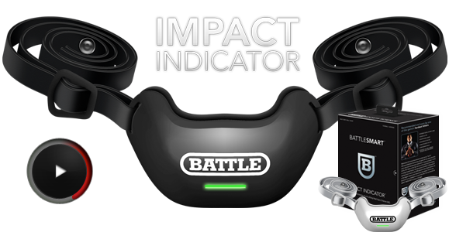
Design Alternatives: Position
Battle Sports Science Impact Indicator
http://www.battlesportsscience.com/products/impact-indicator/about-the-indicator/
Notes:
Battle Sports Science manufactures a product called the Impact Indicator, which is a chin strap that is attached to a football helmet, and is said to measure the force of impact.

Slide 7
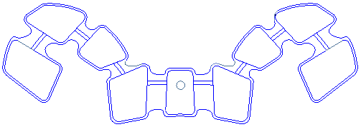
Design Alternatives: Position
Accelerometer
3
2
1
Notes:
three positions shown in the CAD drawing were chosen for preliminary testing

Slide 8
Design Alternatives: Mounting
Embedded in the padding liner (Position 2 & 3)
Mounted in between the lining components (Position 1)
Spring mount (HIT System)

Slide 9
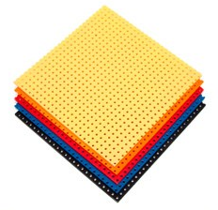
Design Alternatives: Foam
CELL-FLEX® Vinyl Nitrile
600 | Density: 0.095-0.12 g/cm³ Hardness: 55-75 Sheet Size: 42" X 80“ Tensile Strength: 10 kg/cm²
740 | Density: 0.12-0.14 g/cm³ Hardness: 60-80 Sheet Size: 44" X 74" Tensile Strength: 12 kg/cm²
1000 | Density: 0.16-0.22 g/cm³ Hardness: 65-85 Sheet Size: 39" X 63" Tensile Strength: 17 kg/cm²
http://www.dertexcorp.com/impact-resistant-foam.html
Notes:
Rawlings uses the CELL-FLEX® vinyl nitrile 600, 740 and 1000 foam to retrofit the quarterback communication system. Because these foams have been used to retrofit the quarterback communication system into the Rawlings helmet and have performed at very high (4 STAR) levels, these were the three foam options that were being considered for the preliminary tests. In order to retrofit the accelerometer within the padding liner, half the padding needs to be removed. It is also important to note that the foam thickness being used to cover the accelerometer when not embedded in the liner is thinner than that used in the quarterback communication system. As a result, the CELL-FLEX® vinyl nitrile 740 and 1000 foams were chosen for the preliminary testing. Unfortunately, by removing some of the padding, performance of the helmet could be altered. Therefore, a higher density foam, such as the CELL-FLEX® vinyl nitrile 740 or 1000, was chosen to ensure that the performance of the helmet was not compromised.

Slide 10
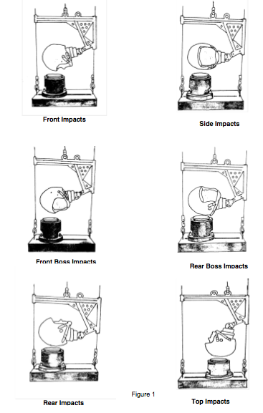
NOCSAE Helmet Drop Test
http://www.nocsae.org/standards/documents.html
Notes:
After exploring different design alternatives, the helmet performance was then analyzed with the accelerometer in the positions determined above using the National Operating Committee on Standards for Athletic Equipment (NOCSAE) helmet drop tests. These tests consist of dropping the helmet at different velocities and helmet angles shown
NOCSAE standards dictate that the Severity Index (SI) values may not exceed 1200 SI on any drop and must not exceed 300 SI on the 3.46 m/s velocity tests.¹⁶

Slide 11
Design Analysis: Accelerometer in Position 1 with ½” VN740 Foam
 | 11.34 - 11.68 |  |  |  | 17.94 - 18.47 |  |  |  | 17.94 - 18.47
Helmet Angle | SI | Pg | ft/s |  | SI | Pg | ft/s |  | SI | Pg | ft/s
Rear position (5) | 0.3039 | 0.25 | 0.01 |  | 0.99 | 0.4661 | -0.01 |  | 0.81 | 0.354 | 0.00
R. Rear Boss position (4) | 0.1837 | 0.106 | 0.00 |  | 0.074 | 0.0345 | 0.01 |  | -0.092 | -0.118 | 0.01
Crown position (6) | -0.112 | -0.01 | -0.01 |  | 0.004 | 0 | 0.01 |  | 0.083 | 0.064 | 0.01
Random Position (15) | 0.0667 | -0.03 | -0.01 |  | 0.174 | 0.0625 | 0.00 |  | 0.037 | 0.036 | 0.00
Random position (16) | 0.1086 | 0.029 | -0.01 |  | 0.855 | 0.4636 | 0.00 |  | 1.027 | 0.602 | 0.01
Random position ( 27) | 0.1825 | 0.094 | -0.01 |  | 0.09 | 0.2353 | -0.01 |  | 0.253 | 0.158 | 0.00
PASSED
$$Percent Change=\frac{AccelerometerData−BaselineData}{BaselineData}$$
Notes:
Compare data to baseline NOCSAE helmet drop data
The accelerometer was stuck to the VN740 foam with an adhesive to keep it from moving in the helmet.
PASSED
Positive values in the table correlate to an increased value with the accelerometer in the helmet, while negative values show a decrease in value with the accelerometer.

Slide 12
Design Analysis: Accelerometer in Position 3 with ½” VN740 Foam
 | 11.34 - 11.68 |  |  |  | 17.94 - 18.47 |  |  |  | 17.94 - 18.47
Helmet Angle | SI | Pg | ft/s |  | SI | Pg | ft/s |  | SI | Pg | ft/s
R. Front Boss position (2) | 0.06 | 0 | 0.00 |  | 0.006 | -0.031 | 0.00 |  | -0.071307 | -0.043 | 0.00
Rear position (5) | -0.1 | 0 | 0.00 |  | 0.0096 | -0.0169 | -0.01 |  | -0.09 | -0.1 | -0.01
R. Rear Boss position (4) | 0.01 | -0.02 | -0.01 |  | 0.2809 | 0.181 | 0.01 |  | -0.08 | -0.134 | 0.01
Crown position (6) | 0.07 | 0 | -0.01 |  | 0.3736 | 0.1284 | 0.00 |  | 0.50 | 0.2 | 0.00
Random Position (15) | 1.37 | 0.542 | -0.01 |  | 2.1994 | 1.0547 | -0.01 |  | 1.89 | 0.9429 | 0.00
FAILED
Notes:
FAILED-too much padding removed; values above 100% greater than the baseline data
Since mounting the accelerometer by embedding it in the padding resulted in a failure of the NOCSAE testing, it was determined that a mounting option similar to the quarterback communication system must be used.

Slide 13
Design Analysis: Repeat Accelerometer in Position 1 with ½” VN740 Foam (No Adhesive)
 | 11.34 - 11.68 |  |  |  | 17.94 - 18.47 |  |  |  | 17.94 - 18.47
Helmet Angle | SI | Pg | ft/s |  | SI | Pg | ft/s |  | SI | Pg | ft/s
Rear position (5) | 0.05 | 0.074 | 0.01 |  | 0.5202 | 0.2797 | -0.01 |  | 0.4 | 0.2462 | 0.00
R. Rear Boss position (4) | -0.12 | -0.06 | -0.02 |  | -0.0383 | -0.0086 | 0.02 |  | -0.173258 | -0.157 | 0.01
Crown position (6) | -0.24 | -0.09 | -0.01 |  | -0.0722 | -0.0068 | 0.00 |  | 0.037037 | 0.0714 | 0.00
Random Position (15) | 0.07 | 0.014 | -0.02 |  | 0.2106 | 0.1172 | 0.00 |  | -0.170362 | -0.136 | 0.00
Random position (16) | -0.05 | -0.01 | -0.01 |  | 0.4928 | 0.3273 | 0.01 |  | 0.274686 | 0.3056 | 0.00
Notes:
PASSED- the greatest difference between the data from this test and the baseline was only 52% which is much lower than when the adhesive was used in the first test.

Slide 14
Design Analysis: Accelerometer in Position 1 with ½” VN1000 Foam
 | 11.34 - 11.68 |  |  |  | 17.94 - 18.47 |  |  |  | 17.94 - 18.47
Helmet Angle | SI | Pg | ft/s |  | SI | Pg | ft/s |  | SI | Pg | ft/s
Rear position (5) | 0.07 | 0.147 | 0.00 |  | 0.5739 | 0.3305 | -0.01 |  | 0.4048 | 0.2 | -0.01
R. Rear Boss position (4) | -0.16 | -0.05 | -0.03 |  | 0.0128 | 0.0517 | 0.02 |  | -0.207156 | -0.173 | 0.01
Crown position (6) | -0.24 | -0.12 | -0.01 |  | -0.1063 | -0.0338 | 0.00 |  | 0.057239 | 0.0857 | 0.00
Random Position (15) | -0.05 | 0.028 | -0.01 |  | 0.099 | 0.0313 | 0.01 |  | 0.075846 | 0.0643 | 0.00
Random position (16) | 0.02 | 0.015 | 0.00 |  | 0.3678 | 0.2909 | 0.01 |  | 0.418312 | 0.3333 | 0.01
Notes:
Different Foam
Because the purpose of the performance tests was to minimize the SI values and the VN740 foam only differed from the baseline SI values by a maximum of 52% as opposed to the 57% for the VN1000 foam, the VN740 foam was selected as the foam to be used in the mounting.

Slide 15
Design Analysis: Accelerometer in Position 1 Sandwiched Between ¼” VN740 Foam
 | 11.34 - 11.68 |  |  |  | 17.94 - 18.47 |  |  |  | 17.94 - 18.47
Helmet Angle | SI | Pg | ft/s |  | SI | Pg | ft/s |  | SI | Pg | ft/s
Rear position (5) | 0.15 | 0.191 | 0.00 |  | 0.8906 | 0.4068 | -0.01 |  | 0.4448 | 0.2231 | -0.02
R. Rear Boss position (4) | -0.18 | -0.08 | -0.02 |  | 0.0043 | 0.0517 | 0.01 |  | -0.167608 | -0.118 | 0.00
Crown position (6) | -0.27 | -0.13 | -0.01 |  | -0.0041 | 0.0405 | 0.00 |  | -0.031425 | 0.0214 | 0.00
Random Position (15) | -0.08 | -0.1 | -0.01 |  | 0.0837 | 0.0078 | 0.01 |  | -0.128355 | -0.1 | 0.00
Random position (16) | 0.06 | 0.029 | 0.00 |  | 0.2808 | 0.2545 | 0.01 |  | 0.576302 | 0.4074 | 0.01
Notes:
With this knowledge, the last test was performed with the accelerometer sandwiched between two sheets of ¼ inch (0.64 cm) VN740 foam to try and minimize the distance between the accelerometer and the player’s head.
Therefore, in terms of helmet performance, the ½ inch (1.27 cm) VN740 foam performs the best.

Slide 16
Design Schedule
 | Sep. 10 | Sep. 17 | Sep. 24 | Oct. 1 | Oct. 8 | Oct. 15 | Oct. 22 | Oct. 29 | Nov. 5 | Nov. 12 | Nov. 17 | Nov. 24 | Dec. 1 | Dec. 5 | Dec. 11
Project Selection
Project Plan
Project Requirements
Literature/Patent Search
Preliminary Report
Accelerometer Positioning
Webpage Active
Helmet Safety Testing
Risk Analysis
Progress Report
Feasibility Report
Normalizing Algorithm
Final Report
Poster Presentation

Slide 17
Specific Details of Chosen Design
Rawlings size large Impulse helmet
Single-unit tri-axial accelerometer measuring linear and rotational acceleration
Accelerometer Position: Position 1
Mounting Option: Similar to that in the quarterback communication system
High Density Foam: VN740
Foam Thickness: ½” (1.27 cm)
No adhesive

Slide 18
Team Responsibilities
 | Seth Bensussen | Naomi Ebstein | Amanda Pavlicek
Responsibilities | First Presentation Design Analysis Poster Application of Normalizing Algorithm | Third Presentation Design Alternatives Website Poster Literature Review on Normalization | Second Presentation Design Alternatives CAD Files Design Specifics Design Safe Poster

Slide 19
References
https://www.braintrauma.org/tbi-faqs/tbi-statistics/
http://abcnews.go.com/US/nfl-players-file-lawsuit-league-concussions/story?id=16514359#.UJC0h8XA_s4
http://espn.go.com/espn/otl/story/_/id/7601017/study-impact-kids-football-head-hits-severe-college-games
http://www.dertexcorp.com/impact-resistant-foam.html
Rowson, Steven. Rotational head kinematics in football impacts: an injury risk function for concussion. Annals of biomedical engineering 40.1 Jan 2012: 1-13. Springer. 22 Sep 2012.
Stack, Kyle. “Concussion-Sensing Chin Strap Raises Questions.” Wired. Wired, 26 March 2012. Web. 26 Oct. 2012. http://www.wired.com/playbook/2012/03/battle-sports-science-impact-indicator/
Gonzales, Juan Meandro and Ryan Matthews. “The Head Impact Telemetry System: The Future of Concussion Safety.” Web. http://136.142.82.187/eng12/history/spring2012/pdf/2105.pdf
Rowson, S, and SM Duma. “Development of the STAR Evaluation System for Football Helmets: Integrating Player Head Impact Exposure and Risk of Concussion.” Annals of Biomedical Engineering. Web. http://www.ncbi.nlm.nih.gov/pubmed/21553135
“Standard Performance Specification for Newly Manufactured Football Helmets.” NOCSAE Standard Documents and Laboratory Guides. Web. http://www.nocsae.org/standards/documents.html

Slide 20
Thank You Questions?

