Slide 1
Rawlings Football Helmet Accelerometer System
Seth Bensussen, Naomi Ebstein, Amanda Pavlicek

Slide 2
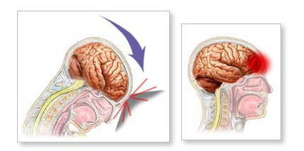
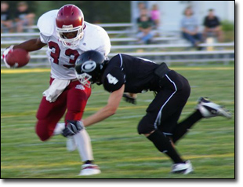
Main Issue
Brain injuries occur in ~1.5 million people in the US each year
300,000 of these are sports related CONCUSSIONS
NFL in 2011, 266 players out of 1,696 suffered CONCUSSIONS (~15%)
Over 2000 ex-football players file lawsuit against NFL
Notes:
Talk about origin of concussions/what happens in head-brain slams against skull without anything cushioning it, all brain cells depolarize at once and causes chemical inbalance in brain for at least a few minutes, also up to 50% less blood flow which inhibits brain from repairing this damage
Talk about lawsuit-long term affects of concussions

Slide 3
Helmet Accelerometer System
Place accelerometer system into helmet
Measure G-force of the center of gravity of the head
Initial step in identifying concussive impacts
Ability to collect data throughout the season
Notes:
Help coaches, team doctors, physicians-know when to take players out, learn more about concussions
Players don’t report concussions, why this system is important

Slide 4
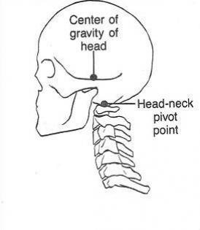
Quantification
Notes:
Mstriking is about 67% higher than mreceiving
Average collision is 15 ms
Hybrid III head for testing is 4.55kg
Peak force about 4.4 kN-relates to 100g
Explain g-force-acceleration of object related to acceleration of gravity, 1g is changing ~22mph/sec, can only endure these high accelerations for very short period of time
.004 sec, 150 g for severe injury, 0.1 sec, 40g for severe injury

Slide 5
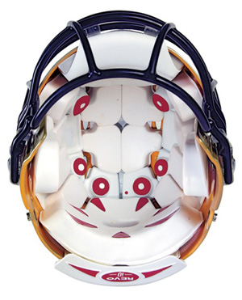
Existing Systems
Helmet Impact Telemetry (HIT) system
Notes:
Hits system-gives magnitude, location, direction of impact, impact history
Hitprofile generates potential hit results based on accelerometers, find one that works best
6 linear accelerometers, calculate rotational

Slide 6
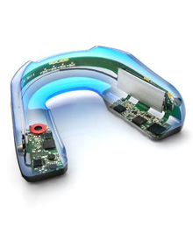
Existing Systems
Impact Intelligence System
Notes:
Stanford athletes using mouthpiece accelerometer system, mouthpiece vs. helmet system mouthguard appears more accurate, helmet supposed to distribute force across head and thus cause increase in other parts of head and give higher reading, liner reduces acceleration of head-part of overestimation

Slide 7
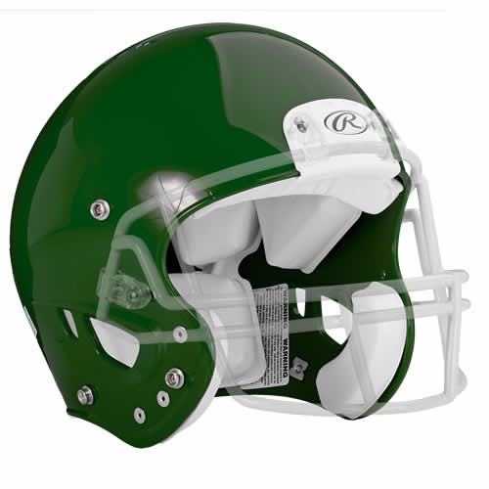
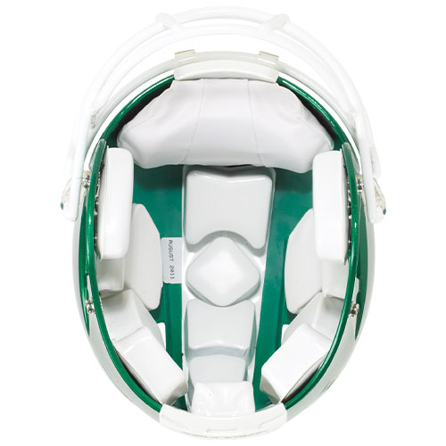
Project Goals
Retrofit a large Rawlings Impulse helmet with an accelerometer system
Compete with existing helmet accelerometer systems
Notes:
Large-head size 7-7 ½, 22-23 ½ “

Slide 8
Project Scope/Design Requirements
Position the accelerometer system into the helmet padding
Test helmet with accelerometer system to ensure performance and safety are not compromised
Use data from tests to develop an algorithm to normalize accelerometer readings to the center of gravity of the head
Notes:
Mention confidentiality agreement-can’t give specs on helmet and accelerometer, also most already designed, partially prototyping
Positioning-ensure accurate readings aka consistent with cg of head
Comfortable-player can’t tell difference with or without accelerometer
Same safety tests used before helmet went out on market-4 star rating-star value<0.4 concussions per season
Heights: 60, 48, 36, 24, 12, and lowest
Locations: front, rear, side, top, for star rating system—(rawlings impulse got 4 stars)
Nocsae-committee for safety-based more on velocity than height
L = helmet location, four total: front, top, side (combined), and rear H = drop height, six total: 60”, 48”, 36”, 24”, 12”, and lowest E = exposure (function of drop height), number of impacts at that drop height for that location a player may experience in one year R = Concussion injury risk (function of peak acceleration) a = peak resultant acceleration
Use accelerometer position, cg of head position, relationship between accelerometer and cg head data

Slide 9
Ideas Based on Research
Place accelerometer in line with center of gravity of the head in one direction
CG of average male head ~3.5 inches below top
Keep accelerometer as close to head as possible
Normalizing algorithm more important than actual position of accelerometer
Z
X
Y
Notes:
Account for reduction in acceleration due to padding
Front to back, top to bottom, through the ears, origin at cg of the head

Slide 10
Preliminary Design Schedule
Find a position for the accelerometer system in the helmet (this week)
Perform initial helmet safety testing (October 1)
Compare accelerometer data to head center of gravity data
Determine if strong relationship between the two
Develop a trendline between the readings
Perform tests over and over to validate data and relationship
Normalize data to the head center of gravity using an algorithm (November 1)

Slide 11
Current Organization of Team Responsibilities
Seth: Background Information, Head Center of Gravity, Existing Technologies, Presentation 1
Amanda: Patents, Safety Tests, Existing Technologies, Acceleration Equations, Presentation 2
Naomi: Background Information, Safety Tests, Existing Technologies, Presentation 3

Slide 12
References
http://iihs.org/ratings/head_restraint_info.html
ftp://ftp.rta.nato.int/PubFullText/RTO/EN/RTO-EN-HFM-113/EN-HFM-113-06.pdf
http://www.rawlingsgear.com/football/football-helmets/impulsea.html
http://www.umm.edu/imagepages/17143.htm
http://medgadget.com/2007/12/impact_sensing_football_helmets_from_riddell.html
http://www.youtube.com/watch?v=BfCrGLcFL94
http://www.bitetech.com/products/contact-sports/impact-sensing-mouthguard/
http://www.freepatentsonline.com/6826509.pdf
http://www.welltemperedmusician.com/index.php?q=sitting-pretty.html
http://www.sbes.vt.edu/pdf/STARMethdology2012.pdf

